Slide 1
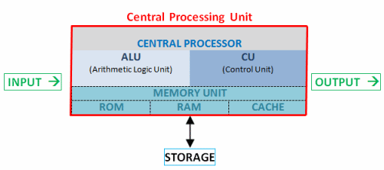
CPU Architecture
Chapter 3 - Lecture 3
Dhanusha Somawardhana
BSc(hons) it (sliIt), mba (uow), Reading DBA(AeU)

Slide 2
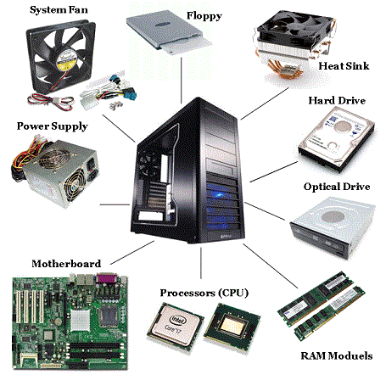
Chapter Overview
Components of the Motherboard
Registers
BUS
ALU
Processor and Coprocessor
DMA (Direct Memory Access)

Slide 3
Mother-Board
Interconnects the PC components.
Divided into main 2 parts (Bus board and Processor board).
Bus Board - Has the slots for the adapters and the interfaces.
Processor Board – Responsible for the co-processor functions and transferring of the instructions

Slide 4
Cont.
The central component of the motherboard is the main processor.
The CPU is associated with a coprocessor for mathematical applications.
Houses a cache controller and a cache RAM to enhance the overall performance of the computer.
Houses other devices like main memory or RAM, the ROM BIOS, the DMA controller , timer, keyboard interface and bus slots.

Slide 5
Basic Components of Motherboard
Processor and Coprocessor – Performs extensive mathematical calculation with high accuracy.
A coprocessor is a special set of circuit s in a microprocessor chip that is designed to manipulate numbers or perform some other specialized function more quickly than the basic microprocessor circuits could perform the same task.
The RAM (Random Access Memory) - Temporarily store data
Bus –Address Bus and Data Bus (For data transferring)
Cache - smaller and faster memory locations in the mother board

Slide 6
Cont.
ROM - contains some programs and data that are required by the computer during power up.
BUS Slots - The slots into which the various buses in the system are connected.
DMS - transfer extensive amount of data between the secondary memory and the primary memory or vice versa.
Time - supply a clock signal based on which the CPU performs its operations and issues timer interrupts to update to internal clock and to refresh the contents of the RAM.

Slide 7
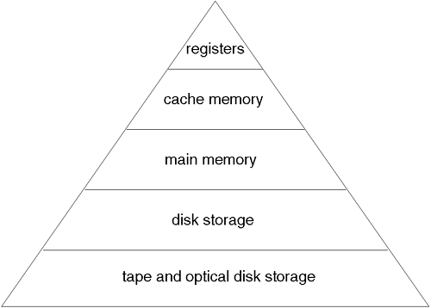
Memory Hierarchy

Slide 8
ALU
Section where all the arithmetic and logical functions are carried out.
Must be able to handle two data, words and the result.
This concept is dependent on the storage and processing techniques.
Usually involved for comparisons as well.

Slide 9
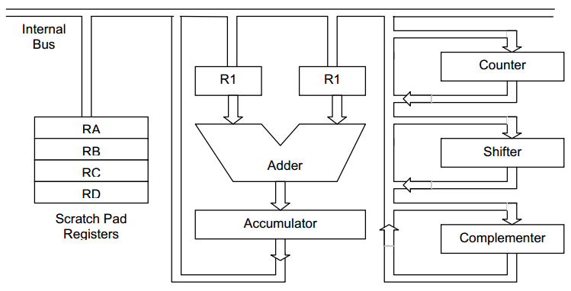
Cont.

Slide 10
Components of ALU
Adder - The adder is a hardware unit that is used to find the sum of two numbers and generate a result.
Accumulator - The accumulator, as explained above, is a hardware register that is used to store the result of the pervious arithmetic or logic operation performed by the ALU.
General Purpose Register (GPR) - GPRs can store data for multiple purpose like storing operands, operand addresses or constants.
Scratch Pad Registers - It is often the case that when we do a very complicated calculation.
Shifter - When dealing with 2’s complement format of numbering
Complementer - The shifter requires the input in 2’s complement format. The complementer is used to provide the 2’s complement of a binary number

Slide 11
ALU Architecture
The ALU needs operands to function and produces a result,
The data is first fed into the primary storage from the input devices.
They are then transferred to the ALU, as and when required.
ALU produces intermediate results during the processing of complicated expressions.
These intermediate values are temporarily stored in designated working storage area until they are required.
Data may flow several times between the primary storage and the ALU before the processing is over
the result is released to an output storage section and from there to an output device.

Slide 12
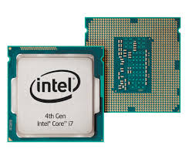
Processors
The microprocessor actually performs the execution of the commands.

Slide 13
Internal Organization of a Processor
The 8088 processor has two processing units:
The execution unit (EU)
The bus interface unit (BIU).
The bus related external jobs are handled by the BUI
The internal operations are carried out by the EU.
EU and BIU work independent of each other.

Slide 14
Execution Unit
Execution Unit Consist of,
ALU
General Purpose Registers - Mostly used for arithmetic and logical functions.
Flags – To Show the Status of Operations
Scratch Pad Registers
Control Logic - Tells the computer's memory, arithmetic/logic unit and input and output devices how to respond to a program's instructions.

Slide 15
The Bus Interface Unit
Execution Unit Consist of,
Instruction Queue - Made up of 4 bytes and is used to store the instructions that are fetched by the BIU.
Address Calculation Unit - Used to calculate the address of the operands or of the instruction itself.
Segment Registers - Used during memory access
Instruction Pointer - Used to point to the next instruction that is to be fetched

Slide 16
Processor Operation
Data Transfer
Memory Addressing – Memory segments
The RESET Action
I/O Addressing
Direct I/O
Memory Mapped I/O
Interrupt Handling
Maskable Interrupts
Non-Maskable Interrupts.

Slide 17
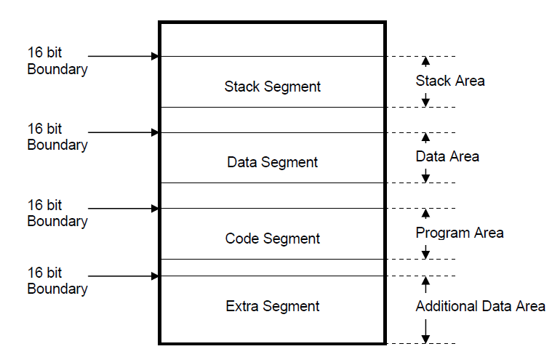
Memory Segments

Slide 18
Co- Processor
Termed as an assistant to the processor.
Mostly used for performing arithmetic operations.
The Operations are performed much faster and the processor becomes free to perform some other task.

Slide 19
Registers
Small storage components that are used for a very fast access of data.
Directly access the hardware access them through the registers.
Registers have limited effect to the microprocessor.
Adding more registers make a program more efficient.

Slide 20
How registers work?
User instructs the application program to open a file.
This command is converted into a system call to the operating system.
The operating system in turn converts the command and accesses the BIOS to execute the user command.
The BIOS then accesses the corresponding hardware with the help of the corresponding register.
The BIOS converts the defined function call into a command sequence for the register concerned

Slide 21
Types of Registers
Instruction Pointer - Used to point to the next instruction that is to be fetched by the processor for execution.
Flag Register - Collection of a number of flags that are required by the processor for performing various operations.
Segment Registers - used by a processor in a segmented memory environment to point to a particular memory segment.

Slide 22
Cont.
Address Register - Used to store the address of the data that has to be either stored in the main memory or fetched from the main memory.
Data Register - Used to hold the data that has to be transferred between two devices.
Pointer and Index Register - Used by the ALU to perform arithmetic and logical functions.

Slide 23
Cont.
Scratch Pad Registers - Used by the ALU for storing temporary values and intermediate results. These registers are not accessible by any instruction.
Accumulator - Register that is used by the ALU to temporarily hold the results of a previous operation.

Slide 24
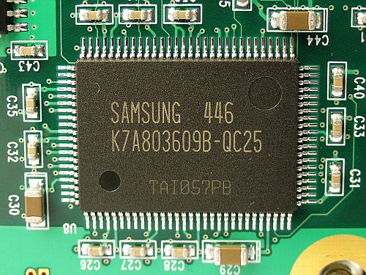
Cache
Compared to the conventional RAM chips, the cache is smaller and faster.
Access time is much lower than conventional RAM.
Cache holds the data that are frequently required by the processor.

Slide 25
How Cache Works?
When the processor requests some data, the cache controller first checks whether the data is present in the cache.
If it is present, then it is immediately made available to the processor.
If the data is not held in the cache memory, then the cache reads the main memory and simultaneously transfers the read data to the processor.
When the processor wants to write to the main memory, it writes onto the cache memory at high speed.
The cache controller then writes the data back to the main memory later.

Slide 26
BUS
Buses are a set of parallel electrical conducting lines that connect various components on the motherboard.
Combined in different ways to suit different functions and each combination is given a different name.
Provide electrical interconnection between the processor components and the interface device used with peripheral equipment.

Slide 27
Cont.
The width of a bus - The number of electrical lines that make up the bus (number of bits it can carry at one instance of time).
16 – bit - 16 electrical lines that combine together to form the bus.
Transfer the data between the processor and peripherals or between different peripherals.
The bus width should match the data path width of the microprocessor.
During data transfer, the entire word may be transferred in one exchange - improve the overall performance of the processor.

Slide 28
Cont.
Adding more number of data lines on to the bus, adds complexity to the circuits in the memory as well as the processor.

Slide 29
Arbitration and Bus-Mastering
A bus that is connected directly to the processor data and address lines are called local bus.
Components are connected via the PC Bus.
The components connected to the bus are in direct contact and control of the processor.
Need not always control the operation of the bus.
The arbitrated expansion bus - design, the processor is not in full control of the bus but it is connected to the bus just as any other component. The control of the bus is handed over to specialized circuits called the bus controller

Slide 30
Dual Bus Architecture
Single Bus has devastating effects on the performance of the computer.
Dual Bus- one for memory and the other for the I/O expansion bus.
Compaq Computer Corporation was the first company to introduced dual-bus PC

Slide 31
Thank You…!!!

